Slide 1
Modeling a Soft Modular Adaptive Robotic Technology (SMART) Arm
MAE263F Midterm Presentation
Che Jin Goh and Agathiya Tharun

Slide 2
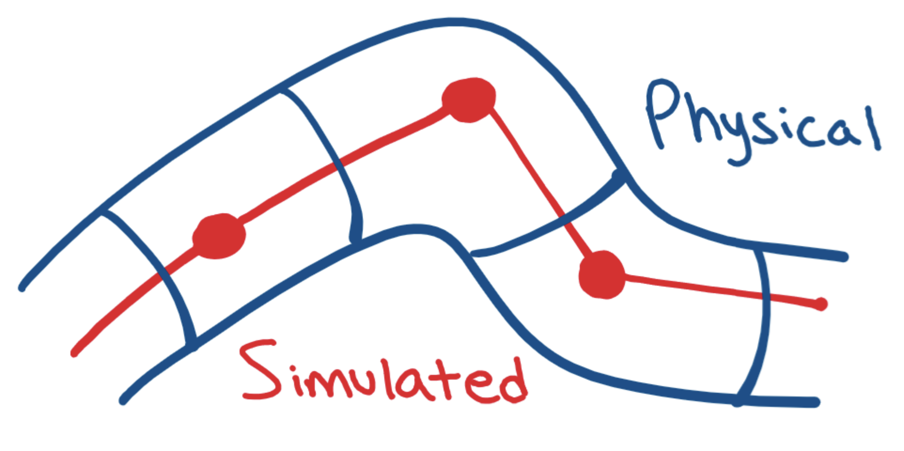
Overview
Goal:
Simulate a modular soft robotic arm
Develop a foundational framework for researchers to leverage and tweak to model their proposal
Method:
Assign variable stiffness to each node
Apply forces to “spawned joints” in a representative way to induce bending
Unstiffened nodes
Figure 1: Simulated vs physical representation of soft arm
Notes:
Forces are applied in a way representative of feasible actuation methods currently employed in physical soft robotic arms (applying nodally instead of at end-effector). Simulates muscle contraction and granular packing methods.

Slide 3
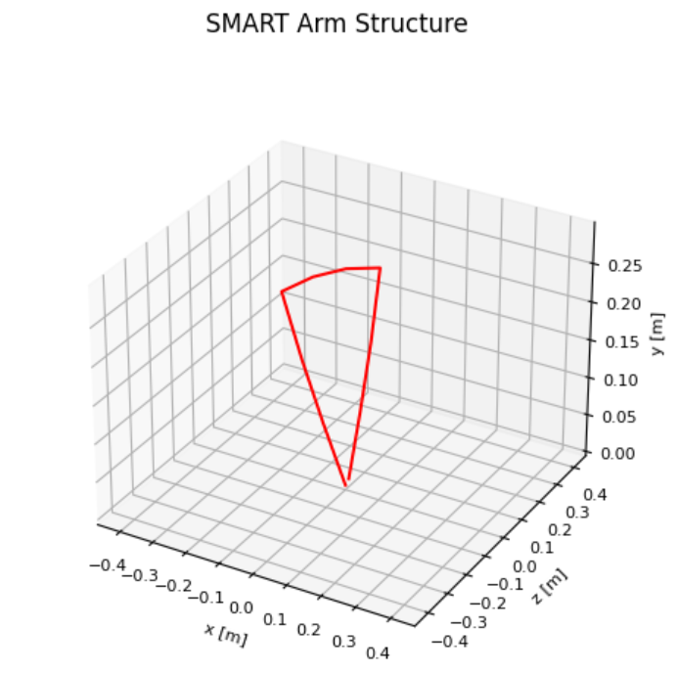
SMART Arm Capabilities
User-defined number of nodes, lengths, and stiffnesses
Applied 1-DOF forces to induce bending at “spawned joints”
Mimics physical contraction and rotational actuation
SMART Arm can reach tight spaces near the base that traditional arms cannot; enhanced workspace
Base
Endpoint
Notes:
Ask prof for a next step on how to simulate the robotic arm moving without it swinging continuously
Fixed the last node at the target position ("goal")

Slide 4
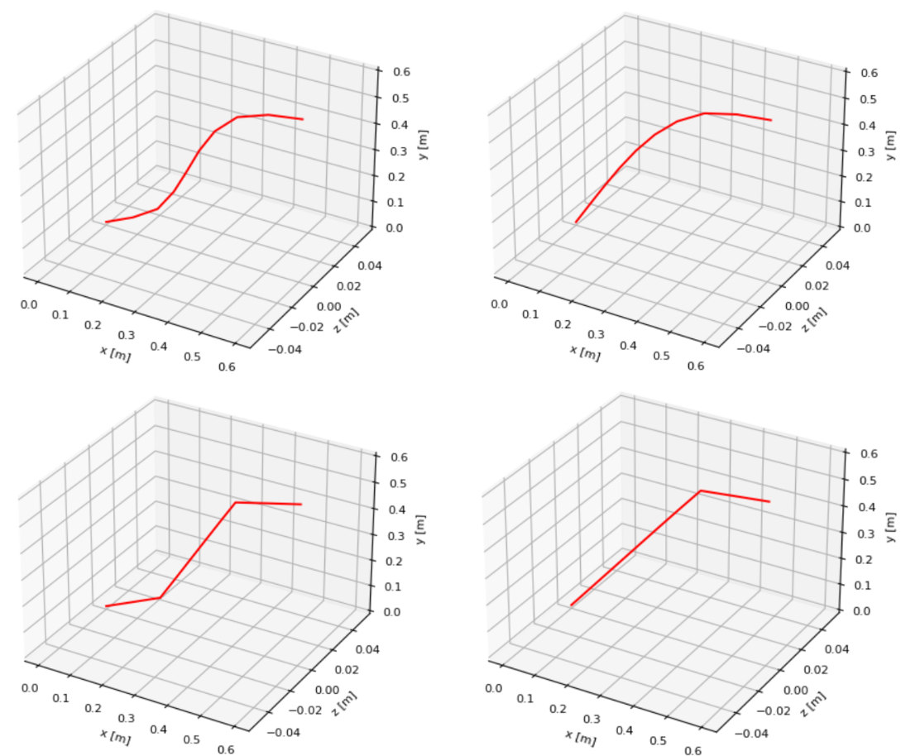
SMART Arm Capabilities
SMART Arm leveraging soft robotic capabilities and variable nodal stiffness
SMART Arm morphing to 1 DOF with variable nodal stiffness
70E6
50E6
Traditional robotic arm with 2 DOF
Traditional robotic arm with 1 DOF
Notes:
Concerns: Researcher has to compute deflection angle to find the forces to apply. With inverse kinematic results, force required needs to be computed.

Slide 5
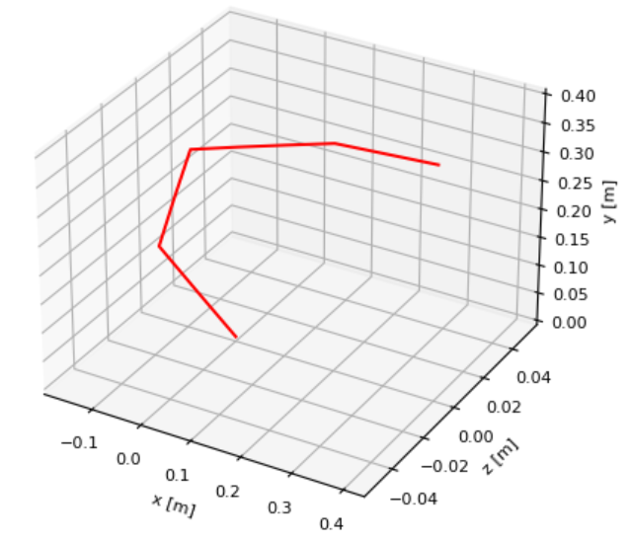
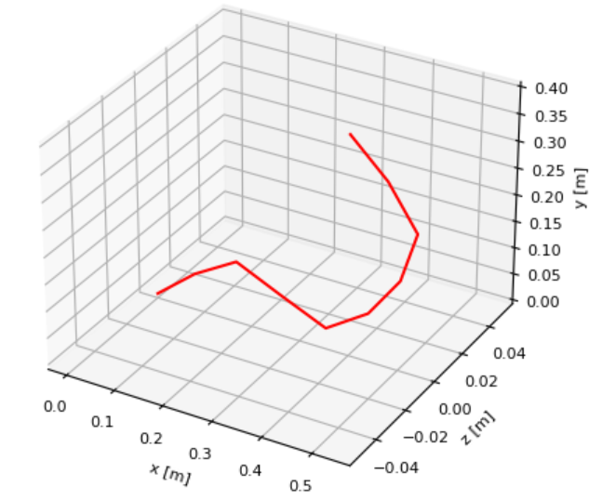
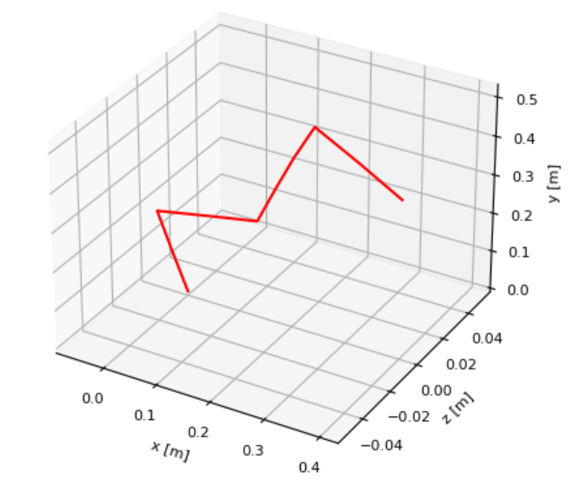
Inverse Kinematics Solver
SMART Arm can be used as an IK solver and produce the shape required to reach an endpoint.
Manual force inputs can be used to dodge obstacles as needed.
Variable stiffnesses are leveraged to vary arm fluidity/continuity
Obs
Obstacle
Obs
Obstacle
Obs
Notes:
Given an inputted end effector location, our framework can work like an inverse kinematics solver and produce the necessary angles to achieve an end point. In addition, our framework can also adapt around any obstacles as well. Dodging an obstacle can be modeled by a manual force input at a node.

Slide 6
References
Hajiesmaili, E., & Clarke, D. R. (2021). Dielectric elastomer actuators. Retrieved from https://pubs.aip.org/aip/jap/article/129/15/151102/1025587/Dielectric-elastomer-actuators
(N.d.). Retrieved from https://ieeexplore.ieee.org/stamp/stamp.jsp?tp=&arnumber=8722799
Jiang, H., Wang, Z., Jin, Y., Chen, X., Li, P., Gan, Y., … Chen, X. (2021). The International Journal of Robotics Research, 40(1), 411–434. doi:10.1177/0278364920979367
Liow, L., & Howard, D. (2024). Frontiers for Young Minds, 12. doi:10.3389/frym.2024.1341887
Scalet, G. (2020). Two-Way and Multiple-Way Shape Memory Polymers for Soft Robotics: An Overview. Retrieved from https://www.mdpi.com/2076-0825/9/1/10

